Slide 1
Hiring Process Analytics
By- Rahul M Ramchandani

Slide 2
About the Project
The project is to analyze the company's hiring process data and draw meaningful insights from it. The hiring process is a crucial function of any company, and understanding trends such as the number of rejections, interviews, job types, and vacancies can provide valuable insights for the hiring department.

Slide 3
About the Project
Tasks to be performed –
Hiring Analysis
Salary Analysis
Salary Distribution
Departmental Analysis
Position Tier Analysis
Software used :-
Microsoft Excel 2021

Slide 4
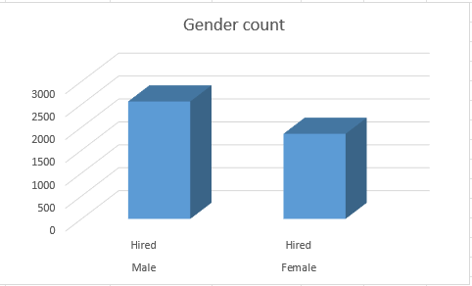

A. Hiring Analysis
Task- How many males and females have been hired by the company?
Formula used : =COUNTIF(B:B, "Male") =COUNTIF(B:B, "Female")
Output-

Slide 5

B. Salary Analysis
Task- What is the average salary offered by this company?
Formula used : Average(A:A)
Output-

Slide 6
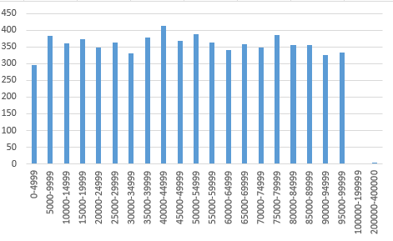
C. Salary Distribution
Task- Create class intervals for the salaries in the company. This will help you understand the salary distribution
Output- Formula used : =FREQUENCY(A2:A7169, D1:D20)

Slide 7
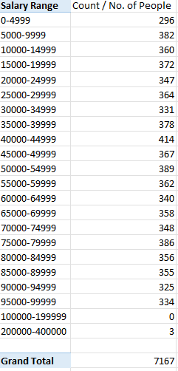
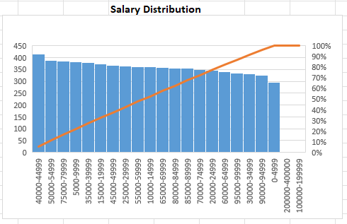
C. Salary Distribution

Slide 8
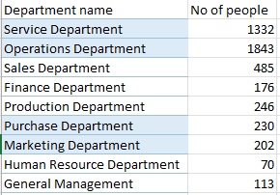
D. Departmental Analysis
Task- Use a pie chart, bar graph, or any other suitable visualization to show the proportion of people working in different departments.
Formula used : =COUNTIFS(Sheet1!E:E, A2, Sheet1!C:C, "Hired")

Slide 9
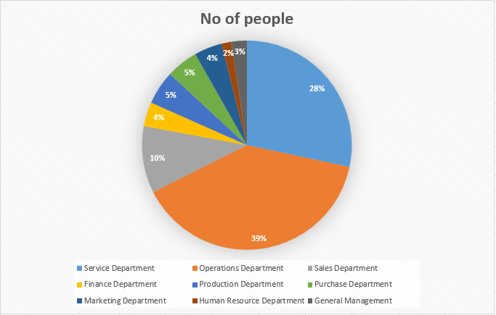
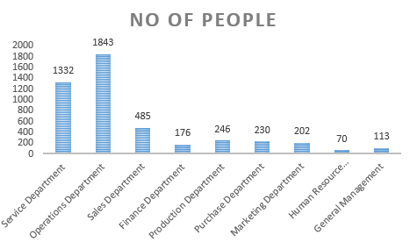
D. Departmental Analysis

Slide 10
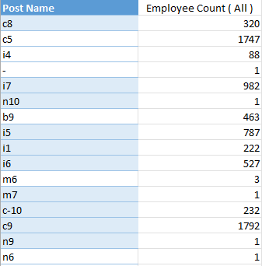
E. Position Tier Analysis
Task- Use a chart or graph to represent the different position tiers within the company. This will help you understand the distribution of positions across different tiers.
Formula used : =COUNTIFS(Sheet1!F:F, A2)

Slide 11
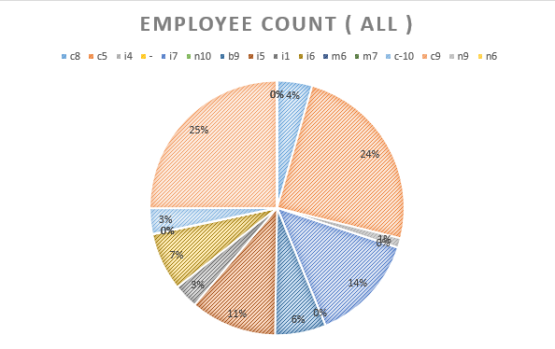
E. Position Tier Analysis

Slide 12
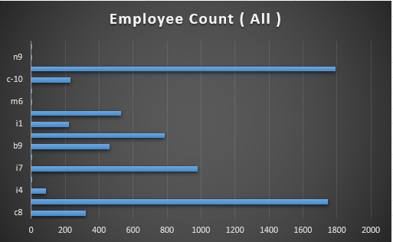
E. Position Tier Analysis

Slide 13
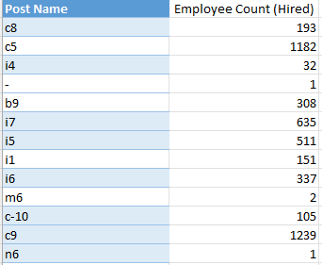
E. Position Tier Analysis

Slide 14
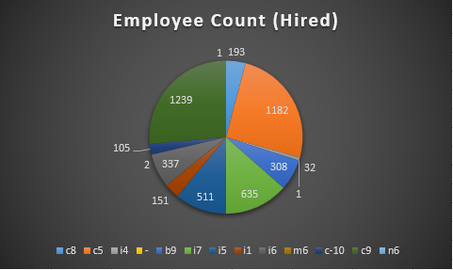
E. Position Tier Analysis

Slide 15
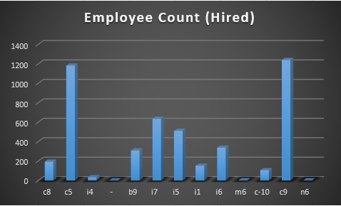
E. Position Tier Analysis

Slide 16
Drive Link
Google drive link for the excel sheet –
https://docs.google.com/spreadsheets/d/1KRrjH727rgqoVmuQZG_e2K3tyLwU8Pfe/edit?usp=sharing&ouid=109013092337571372406&rtpof=true&sd=true

